Slide 1

LLM Engineering
MASTER AI & LARGE LANGUAGE MODELS

Slide 2

PROGRESS REPORT
Showtime
What you can do ALREADY
Write code to call OpenAI's frontier models & summarize
Contrast the leading Frontier LLMs
Intro to transformers, tokens, context windows, API costs and more!
What you'll be able to do BY END OF TODAY
Confidently code with the OpenAI Chat Completions API
Use one-shot prompting, streaming, markdown & json results
Implement a business solution - in a matter of minutes

Slide 3

BUSINESS PROBLEM
Company Sales Brochure Generator
Create a product that can generate marketing brochures about a company
For prospective clients
For investors
For recruitment
The technology
Use Open AI API
Use one-shot prompting
Stream back results and show with formatting

Slide 4



Revisiting the environment setup instructions
Clone the Repo
Follow the README
Create an OpenAI key
See the Green Code button in Github
Anaconda is recommended
Link is in the README
Using a .env file is recommended
Monitor Usage and Billing - should be extremely low for this class!
Then run: jupyter lab

Slide 5


ACTION!
00:10

Slide 6

Congratulations! Week 1 Challenge and Exercise
CHALLENGE
Tweak the Brochure generator
Experiment with the prompting: more examples, different styles
Add another LLM call
How about translating the entire brochure to Spanish
And:
Make something analogous to apply to your business!
EXERCISE
A technical tutor that uses GPT-5-nano or Ollama to answer your questions

Slide 7
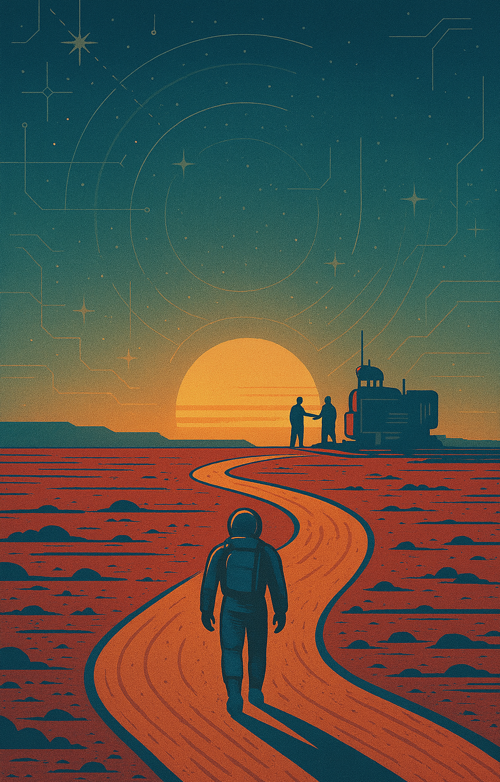
MAJOR ACCOMPLISHMENT
1 week complete!
What you can do
Intro to transformers, tokens, context windows, API costs etc
Contrast the leading Frontier LLMs
Confidently use the OpenAI API including streaming with markdown and JSON generation, and Ollama API
After next week you will be proficient with Frontier Model APIs
Use APIs for OpenAI, Anthropic and Gemini
Work with Agents
Implement a customer support agent with a Chat UI!

